Slide 1
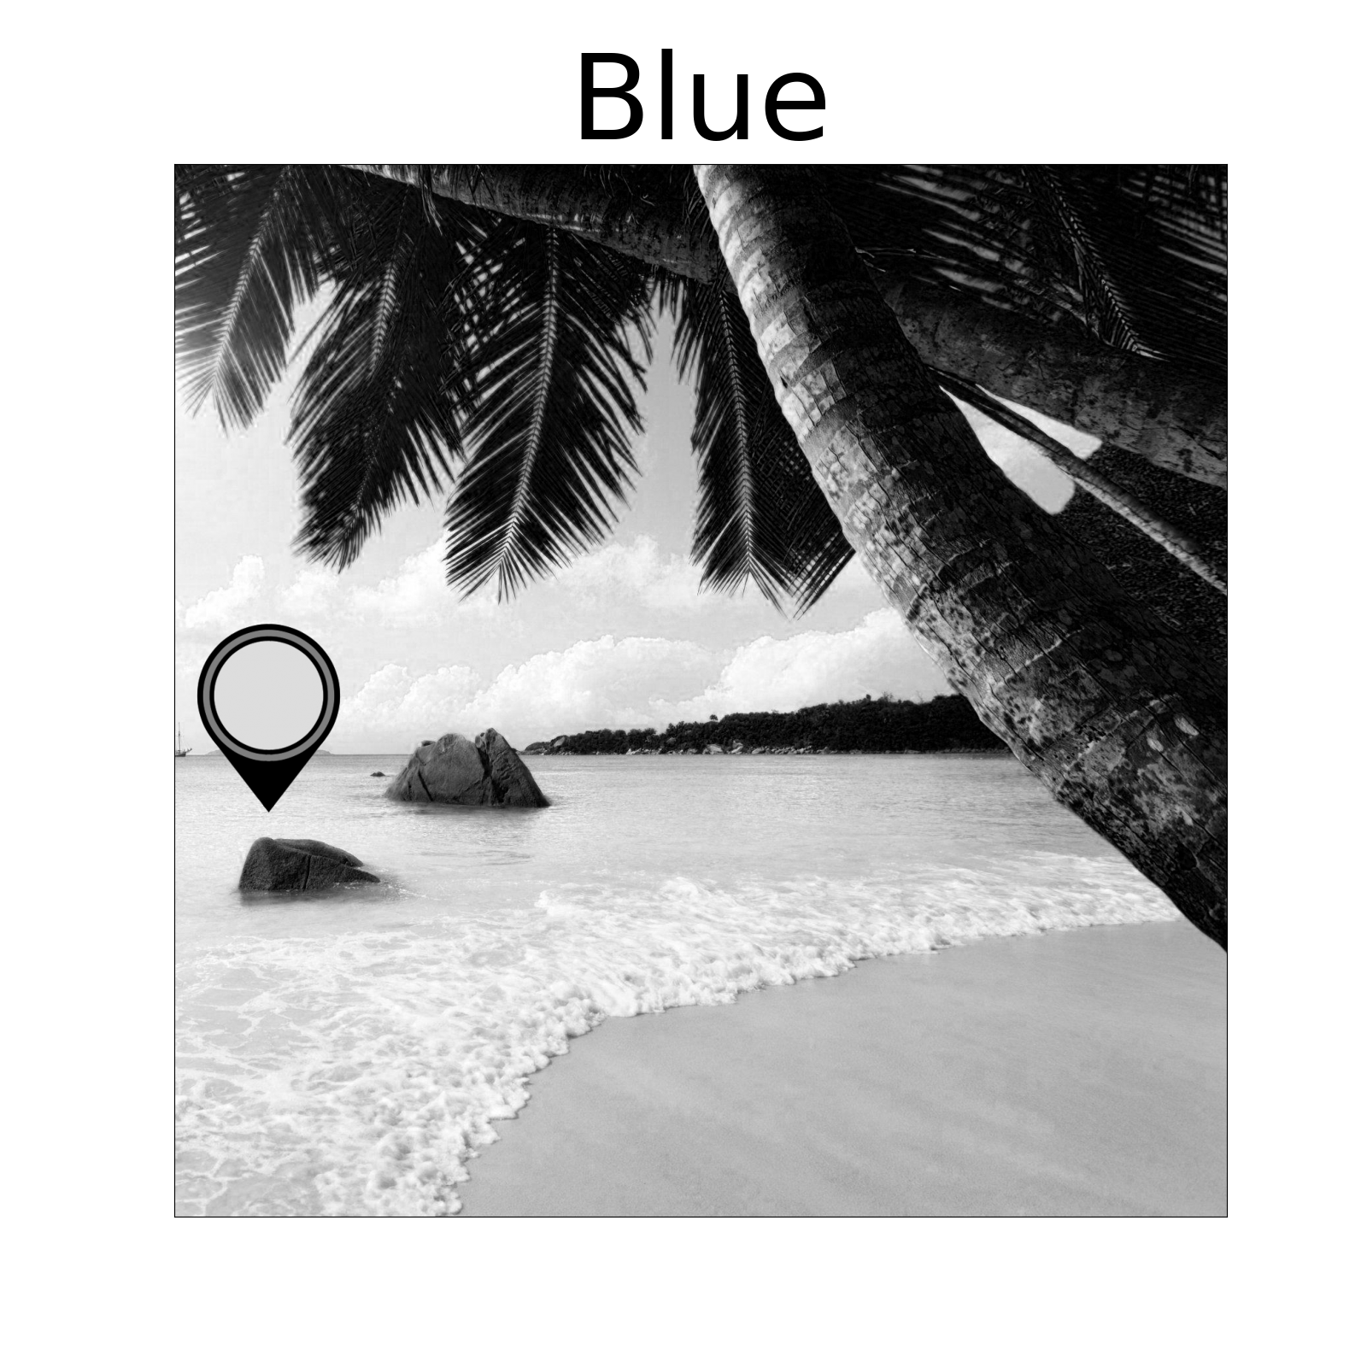
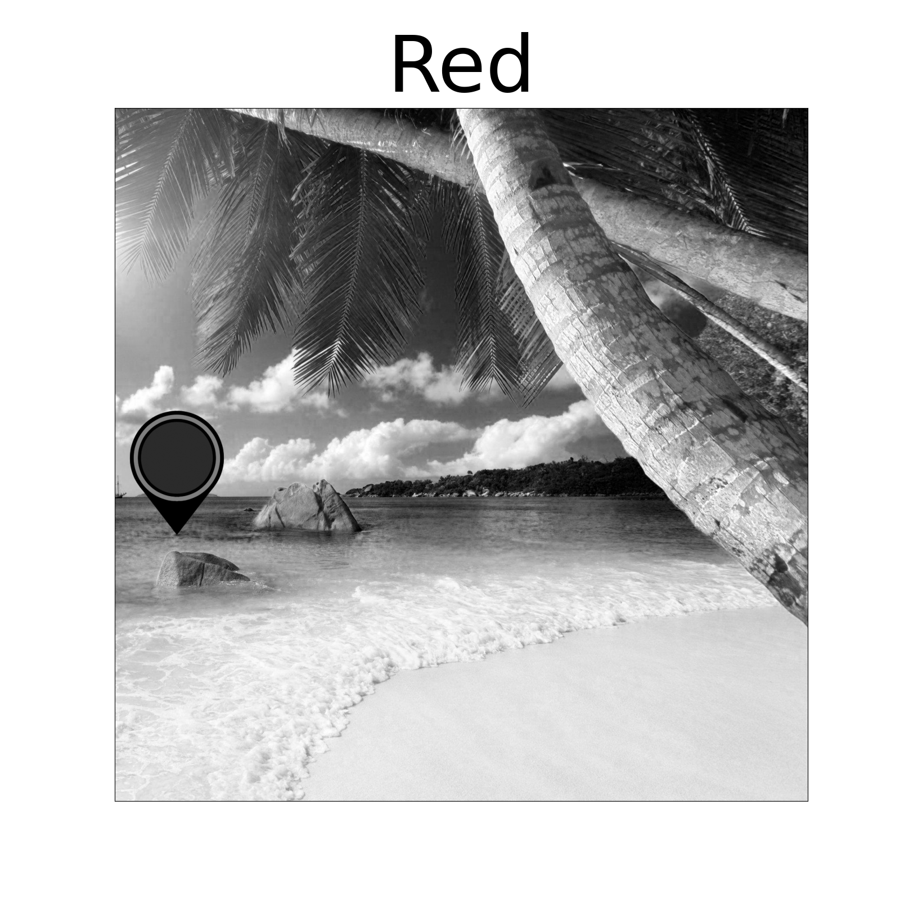
Click the spacebar to shuffle through the filters to recognize the color.
Press the button of the color you think it corresponds to.
Color levels, 0-100:
Red 17
Green 79
Blue 87
Color##
Yellow
Lime green
Green
Turquoise
Blue
Purple

Slide 2
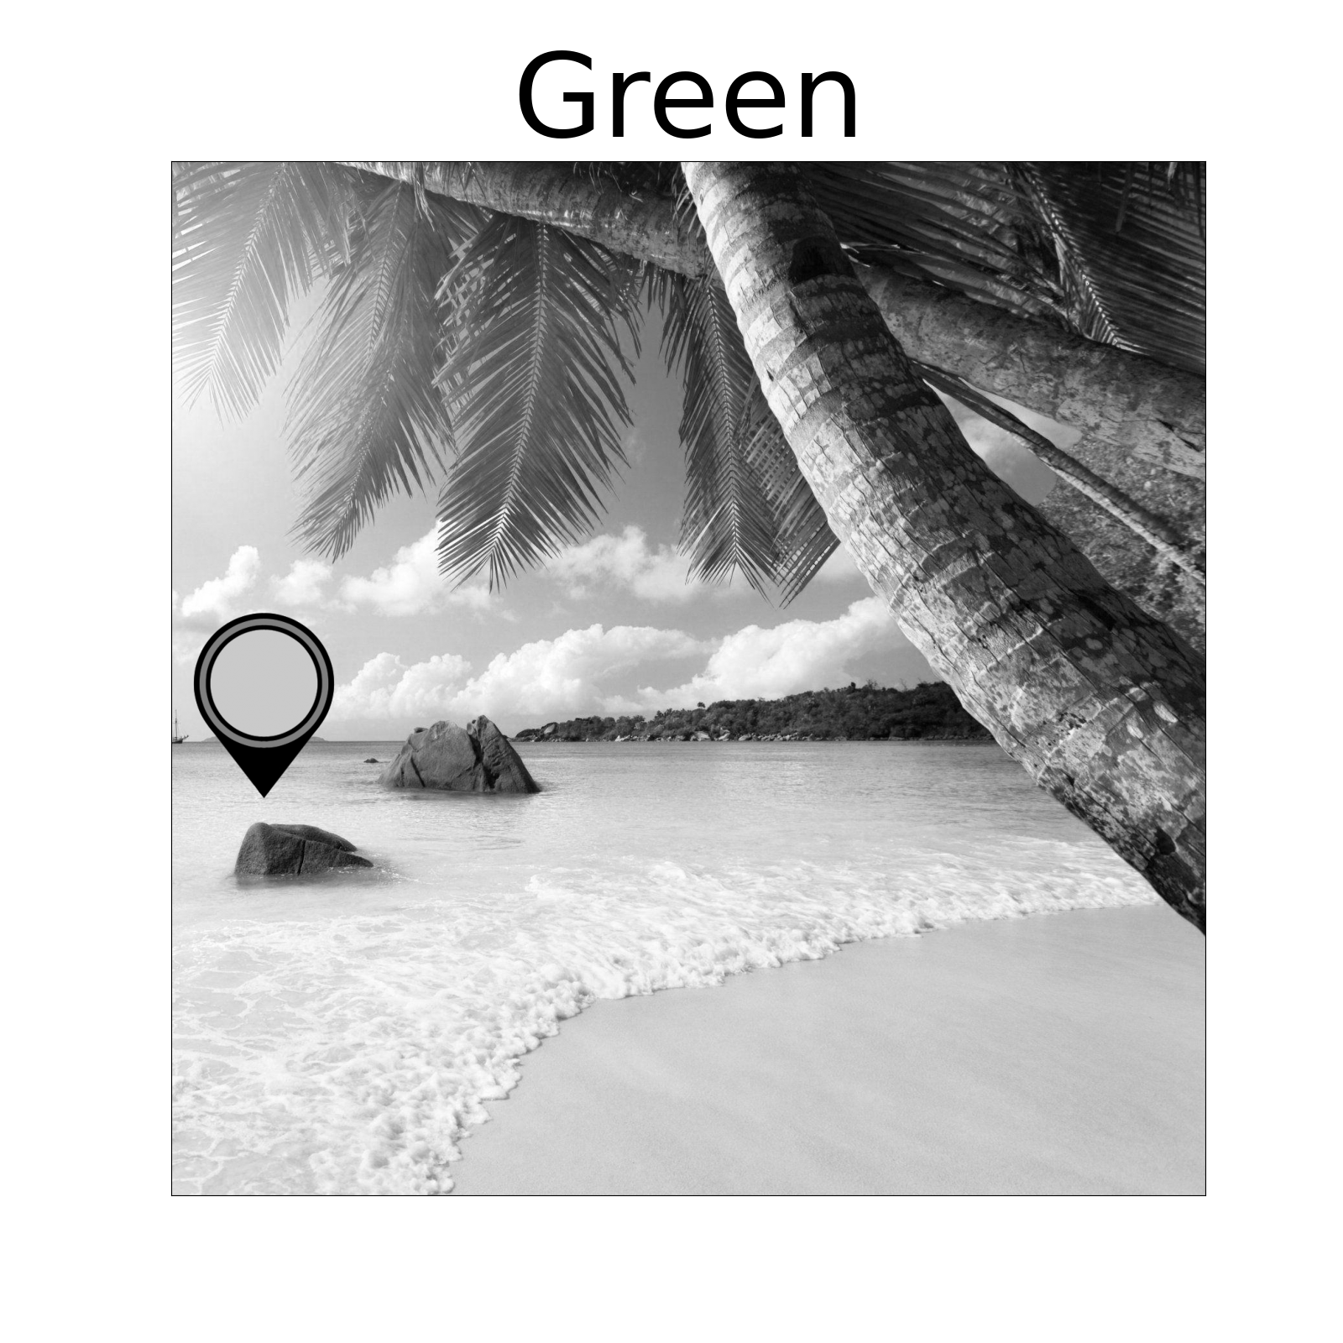
Click the spacebar to shuffle through the filters to recognize the color.
Press the button of the color you think it corresponds to.
Color levels, 0-100:
Red 17
Green 79
Blue 87
Red
Yellow
Lime green
Green
Turquoise
Blue
Purple

Slide 3
Click the spacebar to shuffle through the filters to recognize the color.
Press the button of the color you think it corresponds to.
Color levels, 0-100:
Red 17
Green 79
Blue 87
Red
Yellow
Lime green
Green
Turquoise
Blue
Purple

Slide 4
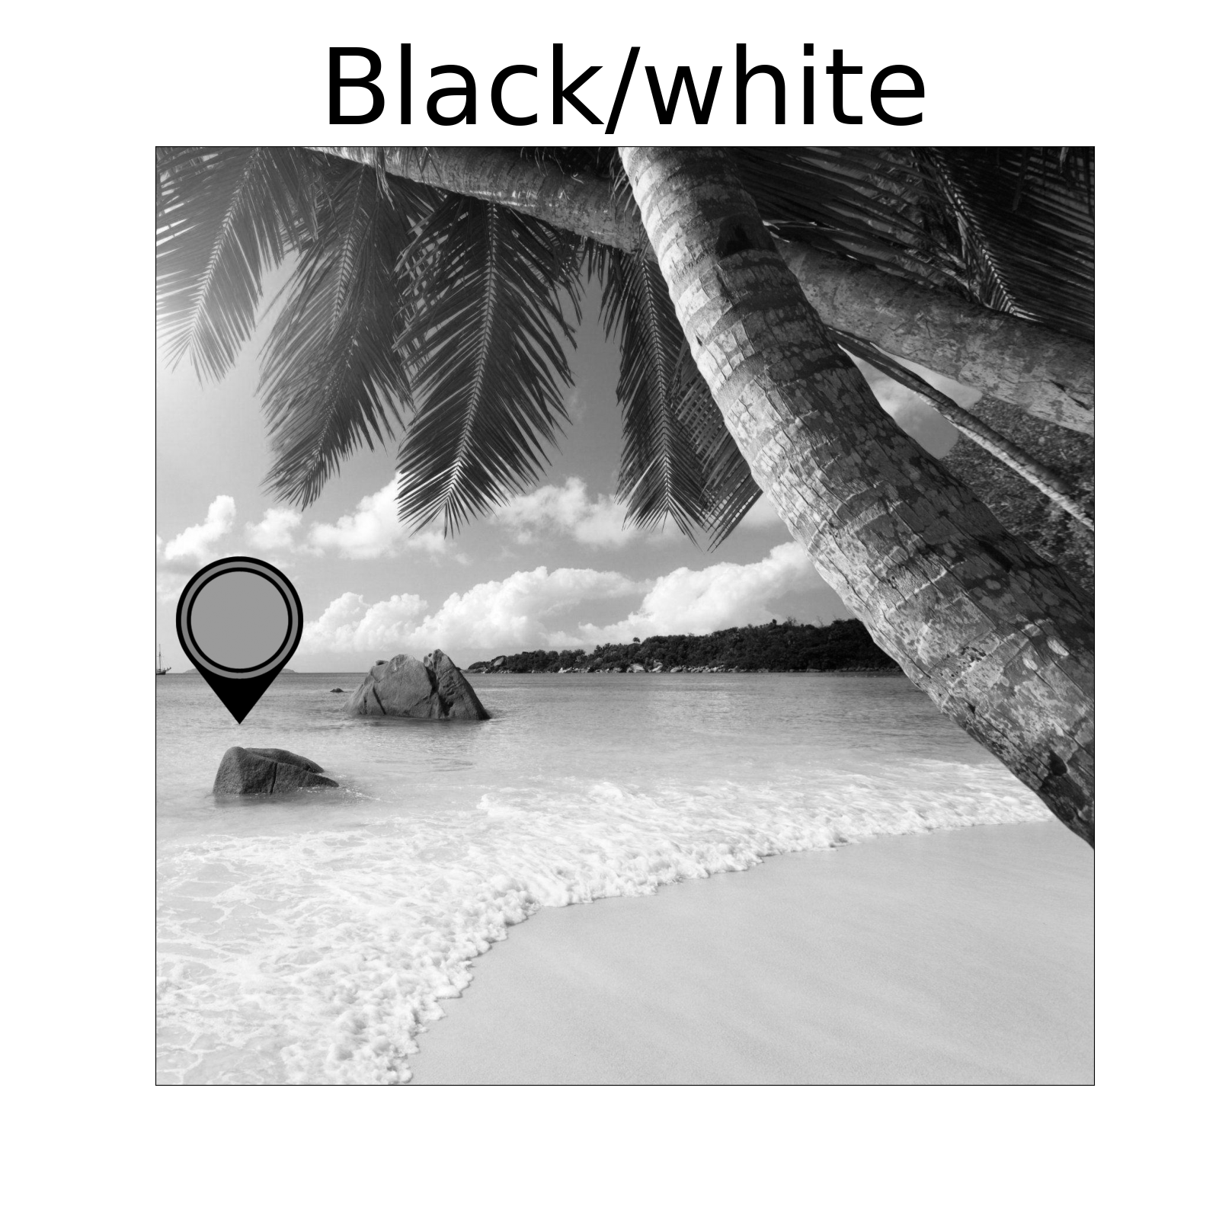
Click the spacebar to shuffle through the filters to recognize the color.
Press the button of the color you think it corresponds to.
Color levels, 0-100:
Red 17
Green 79
Blue 87
Red
Yellow
Lime green
Green
Turquoise
Blue
Purple

Slide 5
How confident in your answer are you?
Drag the slider to the corresponding point.
Color levels, 0-100:
Red 17
Green 79
Blue 87
Red
Yellow
Lime green
Green
Turquoise
Not confident
Very confident
Blue
Purple

Slide 6
You are correct!
This color is
Turquoise
Color levels, 0-100:
Red 17
Green 79
Blue 87
Red
Yellow
Lime green
Green
Turquoise
Blue
Press here to continue
Purple

